Slide 1

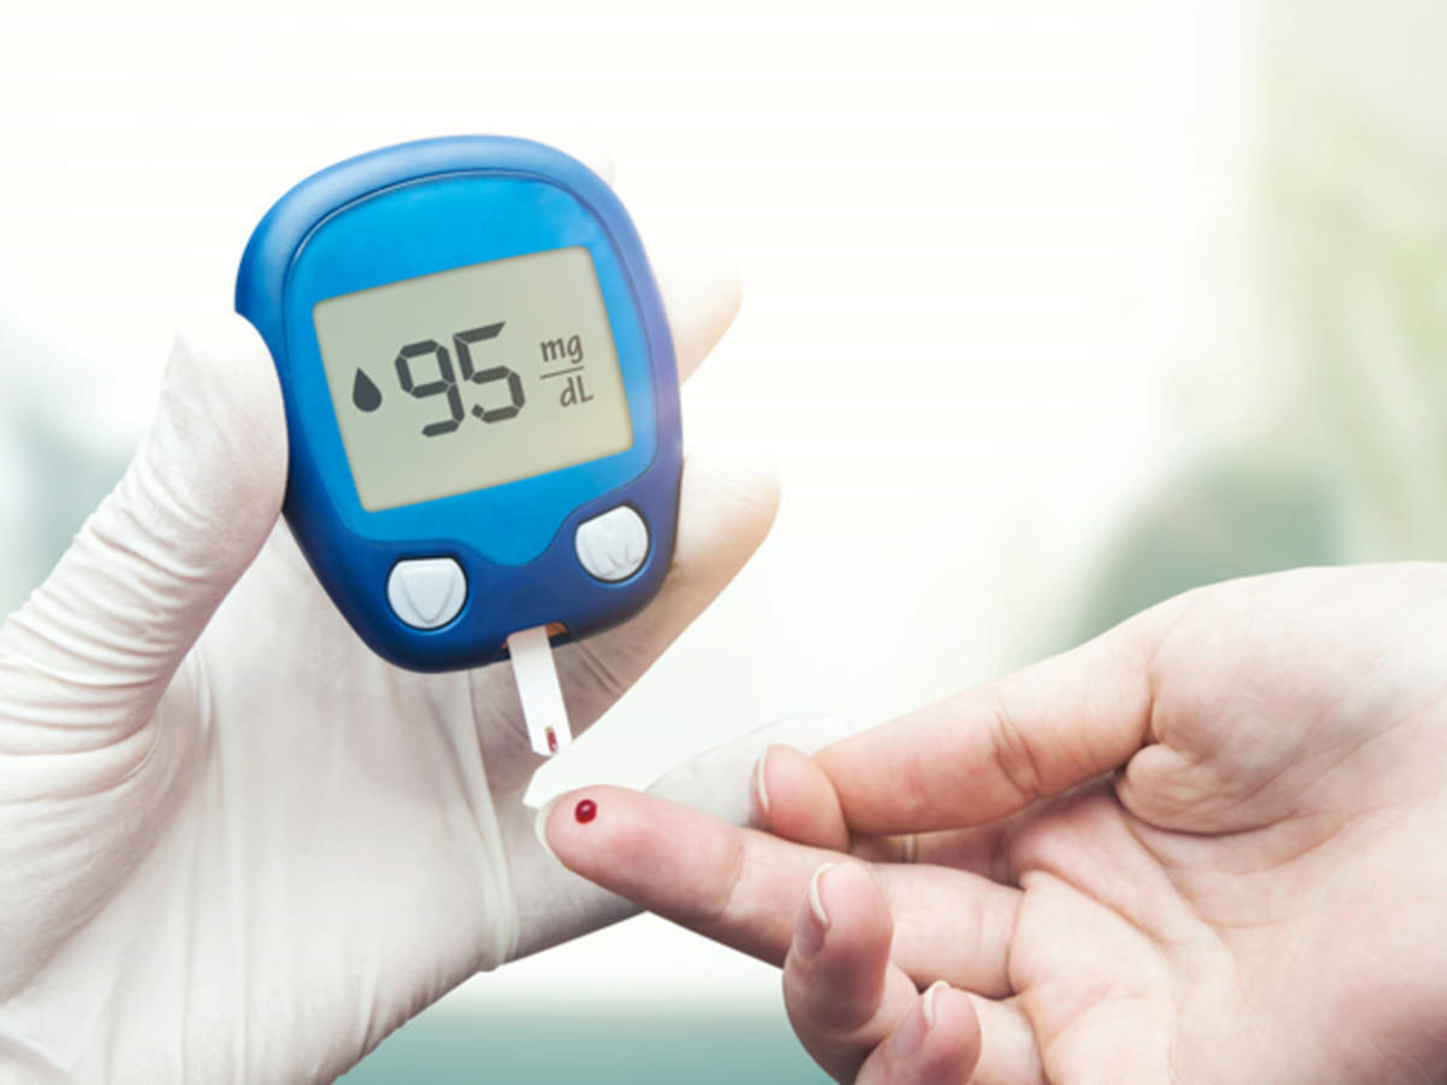
Prediction of Diabetic Using Classification Techniques
Presented By:-
Vivek Singh Rajawat
Btech 3rd Year, CSE
SBCET, JAIPUR

Slide 2

CONTENT
Introduction
Problems and objective
Data Set
Data Pre-Processing
Methodology
Proposed Model for Diabetic prediction
Result Analysis
conclusion
References

Slide 3
INTRODUCTION
Diabetes is a chronic disease. Diabetes is an illness which affects the ability of the body in producing the hormone insulin, which in turn makes the metabolism of carbohydrate abnormal and raise the levels of glucose in the blood.
Person generally suffers from high sugar level in blood which can have severe effects on other human organs.
Insulin is an essential hormone produced by the pancreas that allows the cells to absorb glucose (blood sugar) from food supplies in order to provide them the necessary energy.
In medicine, doctors and current research confirm that if this disease is discovered at an early stage, the chances of recovery will be greater.

Slide 4
PROBLEMS AND OBJECTIVES
Prepare the data set using several methods to train the model.
Build a model which can give high accuracy of predicting the diabetes disease.

Slide 5
Dataset
In this , records of 2000 patients form our experimental dataset.
We used the information of a group of regular outpatients.
The data was collected and selected for the patients from different private hospitals in Central India.
Both, male and female, patients with the age between the range 20 to 75 have been considered.

Slide 6
Data Pre-Processing
Data pre-processing is crucial step.
If the data collected contains any missing attributes or attribute values, contains noisy, outliers, duplicate or wrong data, then resultant accuracy will be depleted.
Moreover, the inconsistencies in the collected data may also affect the subsequent work.
That’s why we have applied pre-processing on the gathered data.

Slide 7
Data Pre-Processing
The transformation steps include:
Retaining some general demographic data like gender and age.
Removing of all text description for experimental accuracy
Representing more descriptive values by binary numbers
Removing of duplicate columns and redundant values from the dataset.
Replacing and/or substituting missing values
Data type classification

Slide 8
Methodology
Various Classifiers that have been used in this study are
Logistic Regression
SVM
KNN
Decision tree
Random forest
Naïve Bayes(GaussionNB)

Slide 9
Logistic Regression
Logistic regression is one of the most popular supervised machine learning algorithms used for predicting categorical dependent variable using a given set of independent variables.
In our study of prediction of Diabetic, our dataset contains two classes i.e. Diabetic and non Diabetic patients. Logistic regression will help us to train the hypothesis and will give us the probabilistic outcome in terms of 1 (Diabetic) and 0 (non Diabetic) cases.

Slide 10
Support Vector Machine (SVM)
SVM is a classification model which basically is a representation of different classes in a hyperplane in multidimensional space.
The goal of the SVM algorithm is to create this hyperplane or decision boundary that can segregate n-dimensional space into classes (Diabetic or Non- Diabetic) so that we can easily put the new data point in the correct category.

Slide 11
K Nearest Neighbors (KNN)
When KNN is used for classification, the output can be calculated as the class with the highest frequency from the K-most similar instances.
K-nearest neighbors (KNN) algorithm uses ‘feature similarity’ to predict the values of new data points which further means that the new data point will be assigned a value based on how closely it matches the points in the training set.
Predictions are made for a new instance (x) by searching through the entire training set for the K most similar instances (the neighbors) and summarizing the output variable for those K instances.

Slide 12
Decision Tree
Decision tree is the most powerful and popular tool for classification and prediction. A Decision tree is a flowchart like tree structure, where each internal node denotes a test on an attribute, each branch represents an outcome of the test, and each leaf node (terminal node) holds a class label. .

Slide 13
Random Forest
Random forest is a commonly-used machine learning algorithm trademarked by Leo Breiman and Adele Cutler, which combines the output of multiple decision trees to reach a single result. Its ease of use and flexibility have fueled its adoption, as it handles both classification and regression problems.
The random forest classifier is a collection of prediction trees, where every tree is dependent on random vectors sampled independently, with similar distribution with every other tree in the random forest.

Slide 14
Naïve Bayes
Naive Bayes is a simple technique for constructing classifiers: models that assign class labels to problem instances, represented as vectors of feature values, where the class labels are drawn from some finite set
Naïve Bayes is one of the fast and easy ML algorithms to predict a class of datasets. It can be used for Binary as well as Multi-class Classifications. It performs well in Multi-class predictions as compared to the other Algorithms. It is the most popular choice for text classification problems.

Slide 15
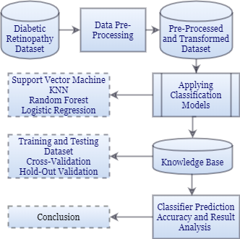
Proposed Model for Diabetic prediction
Logistic Regression
Random Forest
KNN
Support Vector Machine
Decision Tree
Naive Bayes

Slide 16
Result Analysis
Algorithm | Accuracy
Logistic Regression | 78.25%
Naïve Bayes Algorithm | 76.0%
KNN (n=1)Algorithm | 97.25%
Random forest | 99.0%
Decision tree | 98.0%
SVM | 79.0%
The highest accuracy we are getting through Random forest algorithm that is 99.0% and we use Random forest for are model to Diabetic prediction

Slide 17
CONCLUSION
The highest accuracy we are getting through Random forest algorithm that is 99.0% and we use Random forest for are model to Diabetic prediction
The random forest classifier is a collection of prediction trees, where every tree is dependent on random vectors sampled independently, with similar distribution with every other tree in the random forest.
It gives the highest accuracy among different classifiers like logistic Regression, Support Vector Machine, Knn, Naïve Bayes, Decision tree

Slide 18
References
Support Vector Machines for Machine Learning, by Jason Brownlee on April 20, 2016 in Machine Learning Algorithms
K-Nearest Neighbors for Machine Learning, by Jason Brownlee on April 15, 2016 in Machine Learning Algorithms
https://www.javatpoint.com/machine-learning-random-forest-algorithm
Advantages and Disadvantages of Principal Component Analysis in Machine Learning, The Professionals Point, http://theprofessionalspoint.blogspot.com/2019/03/advantages-and-disadvantages-of_4.html

Slide 19

Thank You

